Slide 1
Working with User Input

Slide 2

New Elements

Slide 3
Element List
color datalist date datetime
datetime-local
email month number range search
tel time url week

Slide 4
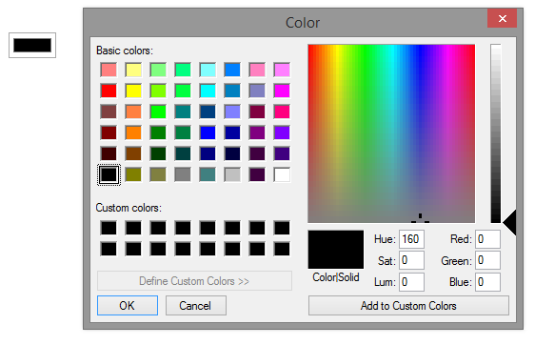
CODE:
<input type="color" />

Slide 5
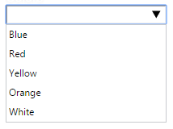
CODE:
<input list="colors"/>
<datalist id="colors">
<option value="Blue">
<option value="Red">
<option value="Yellow">
<option value="Orange">
<option value="White">
</datalist>

Slide 6
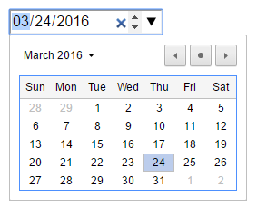
CODE:
<input type="datetime" />

Slide 7
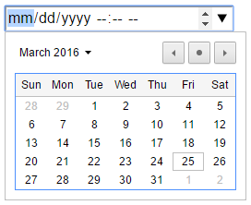
CODE:
<input type="datetime-local" />

Slide 8

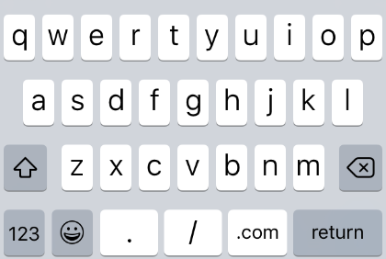
CODE:
<input type="email" />

Slide 9
CODE:
<input type="url" />

Slide 10
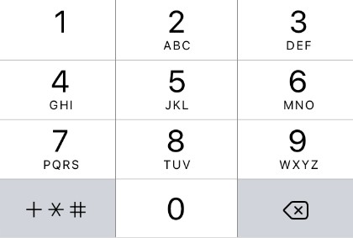
CODE:
<input type="tel" />

Slide 11
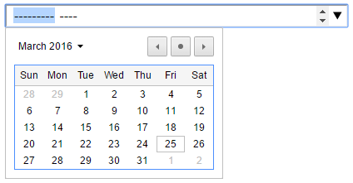
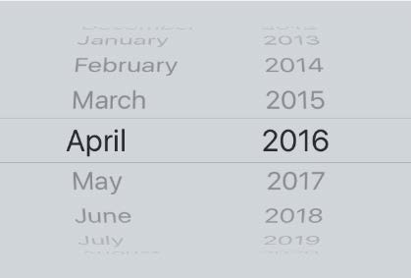
CODE:
<input type="month" />

Slide 12
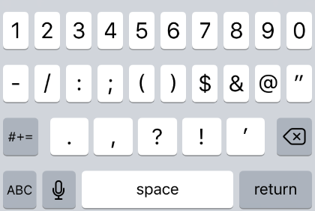

CODE:
<input type="number" />

Slide 13

CODE:
<input type="range" />

Slide 14
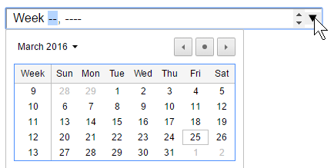
CODE:
<input type="week" />

Slide 15
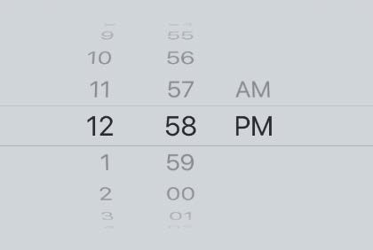

CODE:
<input type="time" />

Slide 16
CODE:
<input type="search" />

Slide 17
Never trust (user) input

Slide 18
Native Validation

Slide 19
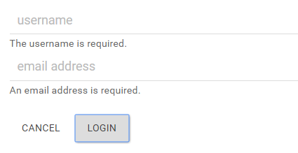

Slide 20
Always replicate validation on the server

Slide 21
Value Missing
<input type="text"
true if an element marked as required has an empty value
required
value="" />

Slide 22
Type Mismatch
true when the value is not matched to declared type
<input
type="url"
value="hi" />

Slide 23
Pattern Mismatch
<input type="text" pattern="/^[A-z]+$/" value="1234"/>
true when an element’s value doesn’t match given regular expression

Slide 24
Too Long
<input type="text" maxlength="3" value="hello"/>
true when an element’s value length is longer than the value in the maxlength attribute

Slide 25
Range Underflow
<input type="range"
true when a range type’s value is smaller than the min attribute
min="3"
max="5" value="0"/>

Slide 26
Range Overflow
<input type="range" min="3"
max="5" value="9"/>
true when a range type’s value is greater than the max attribute

Slide 27
Step Mismatch
<input type="range"
min="5" max="20" step="5" value="8"/>
true when a range type input’s value is impossible given the step value

Slide 28
Valid
<input type="range" min="5"
max="20"
step="5" value="10"/>
true when all other validation rules return false

Slide 29

Demo
Form Basics

Slide 30
Demo
Pseudo Classes

Slide 31
Demo
Native Validation

Slide 32
Demo
Custom Validation

Slide 33
Demo
Bootstrap Module

Slide 34

Summary
Working With User Input
New element types Native validation Custom validation

Slide 35



Next Module
Music and Video
(without Plugins)

